Slide 1
AM Transmitter Block Diagram

Slide 2
Detailed Diagram
Antenna (1MHz modulated signal)
Antenna (2.4GHz @ -24dBm)
Energy Harvester
Variable Resistor
Switching Diode (300mV)
LC Tank w/BJT

Slide 3
Energy Harvester
Patch Antenna (-24dBm @ 2.4GHz)
Bandpass Filter (2-3GHz)
Voltage Multiplier (Increase the Voltage by 4)
DC Output

Slide 4
New Block Diagram
VCC (1V Rail)
Patch Antenna (2.4GHz)
980mV @ 518kHz
Amplifier w/ a Gain of 101
LC BJT Oscillator (518kHz Signal)
Carrier Signal
Gilbert-Cell Modulator
15-20mVpp
45– 980mVpp @ 518kHz (AM)
LC BJT Oscillator
(10kHz Signal)
Message Signal
1.5 – 2V DC

Slide 5
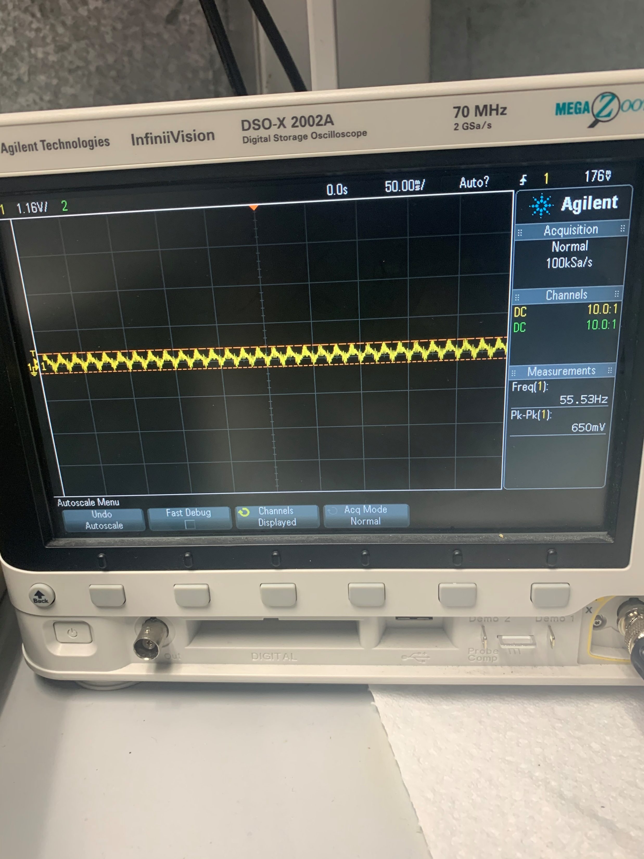
Transmitter Block Diagram
Antenna absorbs ambient Wifi @2.4GHz
VCC (1V Rail)
1.2Vpp @ 518kHz
Amplifier
Oscillator
Switch
20mVpp
1.5 - 2V DC
>3Vpp @ 57Hz

